Slide 1

Object Diagram
By: Nayan Gadhari, Employee ID 6144
Murali Arandala, Employee ID 6145
Abhishek Kumar, Employee ID 6146
Akiri Anil Kumar, Employee ID 6147

Slide 2

What is Object Diagram?
Object diagrams also represent the static view of a system but this static view is a snapshot of the system at a particular moment.
Object diagram represents an instance at a particular moment, which is concrete in nature.

Slide 3
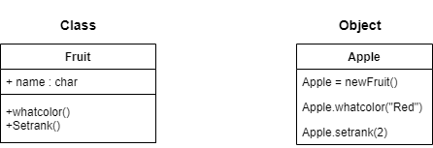
Is Class Diagram same as Object Diagram ?
The difference is that a class diagram represents an abstract model consisting of classes and their relationships.
Object diagram is an instance of a class diagram.

Slide 4
Precondition steps for Object Diagram
First, analyze the system and decide which instances have important data and association.
Second, consider only those instances, which will cover the functionality.
Third, make some optimization as the number of instances are unlimited.
The object diagram should have a meaningful name to indicate its purpose.
Add proper notes at points where more clarity is required.
The association among objects should be clarified.
Values of different elements need to be captured to include in the object diagram.

Slide 5
Object diagram elements
Object diagrams are simple to create: they're made from objects, represented by rectangles, linked together with lines.
Take a look at the major elements of an object diagram.
Objects
Objects are instances of a class. For example, if "car" is a class, then Mercedes is an object of a class.

Slide 6
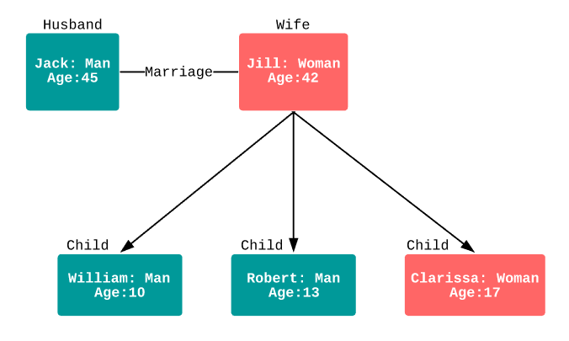
Class titles
Class titles are the specific attributes of a given class. In the family tree object diagram, class titles include
The name, gender, and age of the family members. You can list class titles as items on the object or even in the properties of the object itself (such as colour).

Slide 7
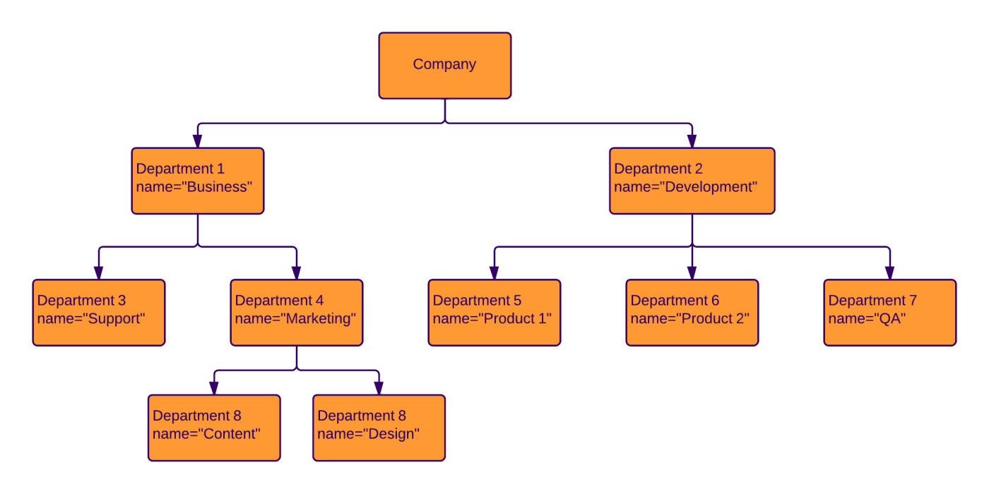
Class attributes
Class attributes are represented by a rectangle with two tabs that indicates a software element.
Links
Links are the lines that connect two shapes of an object diagram to each other.
The corporate object diagram below shows how departments are connected in the traditional organizational chart style.

Slide 8
Application of Object Diagram
The following are the application areas where the object diagrams can be used.
To build a prototype of a system.
To model complex data structures.
To perceive the system from a practical perspective.
Reverse engineering.

Slide 9
Uses of an object diagram
Model the static design(similar to class diagrams ) or structure of a system using prototypical instances and real data.
Helps us to understand the functionalities that the system should deliver to the users.
Understand relationships between objects.
Visualise, document, construct and design a static frame showing instances of objects and their relationships in the dynamic story of life of a system.
Verify the class diagrams for completeness and accuracy by using Object Diagrams as specific test cases.
Discover facts and dependencies between specific instances and depicting specific examples of classifiers.

Slide 10
Advantages
Most-Used and Flexible. ... The Software Architecture Must Be Communicated Effectively. You Need to Know Only a Fraction of the Language to Use It. Abundance of UML Tools. Formal Notation is Not Necessary. Ascending Degree of Complexity. Not Necessary in ‘Architecture-Indifferent Design’

Slide 11
THANK YOU

